Slide 1
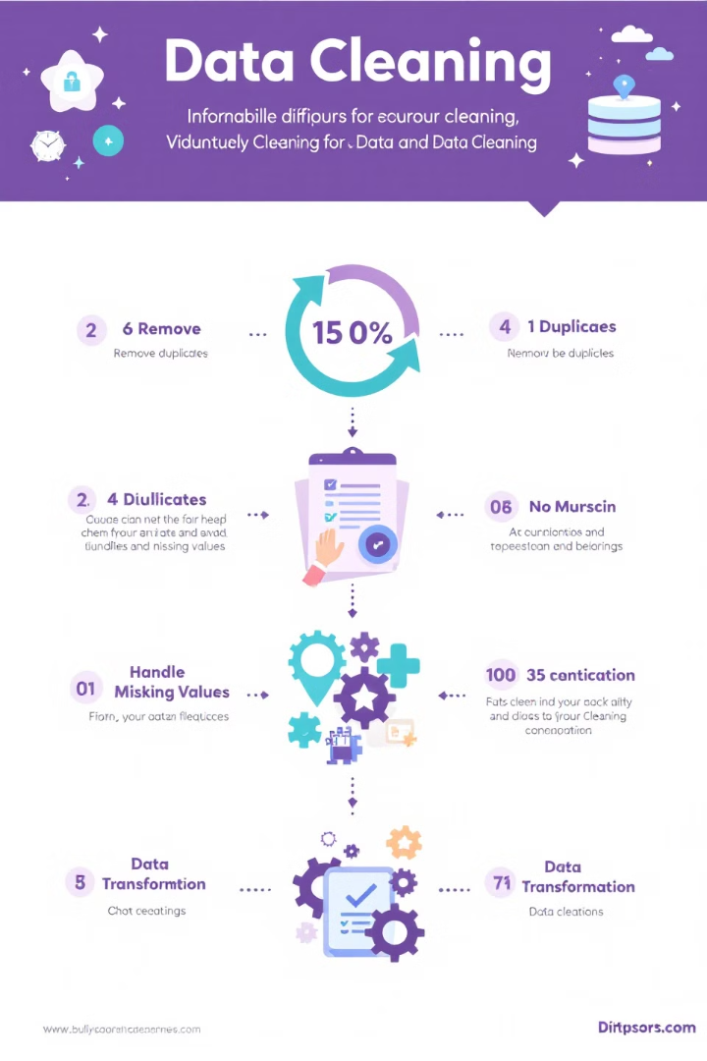

Data Cleaning: A Crucial Step in Data Analysis
Data cleaning is a fundamental step in the data analysis process. This introduction will cover the importance of data cleaning, and the types of data issues commonly encountered, followed by hands-on basics for effective data cleaning techniques.
by Dr. Tri Basuki Kurniawan

Slide 2

The Importance of Data Cleaning
Data Quality
Decision Making
Efficiency
Data cleaning is crucial for ensuring the quality and reliability of your data. It helps to remove errors, inconsistencies, and inaccuracies that could lead to flawed analysis and incorrect conclusions.
Clean data is essential for making informed decisions. By eliminating data issues, you can trust that your analysis is based on accurate and reliable information.
Cleaning data early in the process saves time and resources in the long run. It prevents errors from propagating through your analysis and reduces the need for rework.

Slide 3
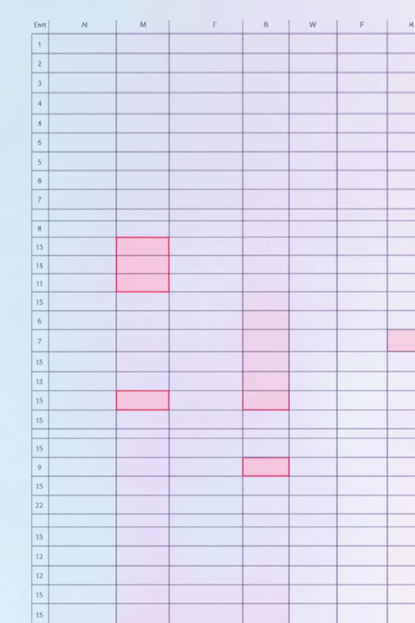
Types of Data Issues: Missing Values
1
Definition
Missing values are data points that are absent from the dataset. They can occur due to various reasons such as data entry errors, system failures, or intentional omissions.
2
Impact
Missing values can significantly affect the accuracy of your analysis and lead to biased results if not handled properly.
3
Detection
Identifying missing values is typically the first step in data cleaning. Most data analysis tools have built-in functions to detect and highlight missing data.

Slide 4




Types of Data Issues: Duplicates
Identify
Verify
Remove
The first step in handling duplicates is to identify them. This can be done using various tools and techniques that compare records and flag potential duplicates.
Once potential duplicates are identified, it's important to verify if they are indeed duplicates or if there's a valid reason for the similarity.
After verification, remove the duplicate entries while ensuring that you retain the most accurate and complete version of the data.

Slide 5
Types of Data Issues: Inconsistencies
Format Inconsistencies
Value Inconsistencies
Unit Inconsistencies
These occur when the same type of data is represented in different formats. For example, dates might be written as "MM/DD/YYYY" in some entries and "DD-MM-YYYY" in others.
These happen when the same information is represented differently across entries. For instance, "United States" might be written as "USA", "US", or "America" in different rows.
These occur when measurements are recorded in different units. For example, some temperatures might be in Celsius while others are in Fahrenheit.

Slide 6

Hands-On: Data Cleaning Basics
1
Preparation
Before starting the data cleaning process, it's important to make a copy of your original dataset. This ensures you have a backup in case anything goes wrong during the cleaning process.
2
Exploration
Begin by exploring your data to get a sense of its structure and potential issues. This can involve using summary statistics, data visualization, and other exploratory techniques.
3
Cleaning
Apply various cleaning techniques to address the identified issues. This includes handling missing values, removing duplicates, and correcting data inconsistencies.
4
Validation
After cleaning, validate your results to ensure the cleaning process was effective and didn't introduce new errors.

Slide 7

Identifying Missing Values
1
Visual Inspection
Start by visually inspecting your data. Missing values often appear as blank cells, "N/A", or special characters like "?" or "-".
2
Statistical Tools
Use statistical software or programming languages with built-in functions to identify missing values. These tools can quickly scan large datasets and flag missing entries.
3
Data Profiling
Employ data profiling techniques to get a comprehensive view of your data, including the percentage of missing values in each column.

Slide 8



Handling Missing Values
Deletion
Imputation
Flagging
In some cases, you may choose to delete rows or columns with missing values. This is suitable when the missing data is minimal and randomly distributed.
Imputation involves filling in missing values with estimated ones. Common methods include mean imputation, median imputation, or using more advanced techniques like regression imputation.
Create a new variable to indicate whether a value was originally missing. This can be useful for future analysis and understanding the impact of missing data.

Slide 9



Removing Duplicates: Step 1 - Identification
Exact Duplicates
Partial Duplicates
Use of Tools
Start by identifying exact duplicates, where all values in a row are identical to another row.
Look for partial duplicates, where some key fields are identical but others may differ slightly.
Utilize built-in functions in spreadsheet software or programming languages to identify duplicates efficiently.

Slide 10



Removing Duplicates: Step 2 - Verification
Manual Review
Automated Checks
Domain Knowledge
For smaller datasets or critical data, manually review identified duplicates to ensure they are indeed unnecessary repetitions.
Use automated checks to verify duplicates in larger datasets. This can involve comparing key fields or using similarity scores.
Apply domain knowledge to determine if apparent duplicates are actually distinct entries that happen to share similar characteristics.

Slide 11





Removing Duplicates: Step 3 - Removal
Select Method
Choose between keeping the first instance, and the last instance, or merging
information from duplicate entries.
Apply Removal
Use the appropriate function or code to remove the duplicates based on your chosen method.
Document Changes
Keep a record of how many duplicates were removed and which method was used for
future reference.
Verify Results
After removal, verify that the duplicates have been successfully eliminated
without unintended consequences to the dataset.

Slide 12

Correcting Data Inconsistencies: Identification
Data Profiling
Pattern Matching
Statistical Analysis
Use data profiling tools to get an overview of your data's structure, formats, and value distributions. This can help identify inconsistencies across the dataset.
Employ pattern matching techniques to identify entries that don't conform to expected formats or patterns.
Conduct statistical analysis to identify outliers or values that deviate significantly from the norm, which could indicate inconsistencies.

Slide 13

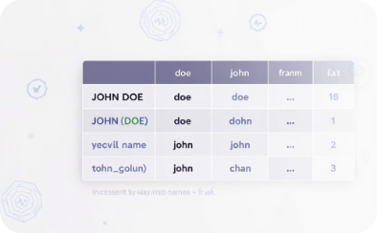
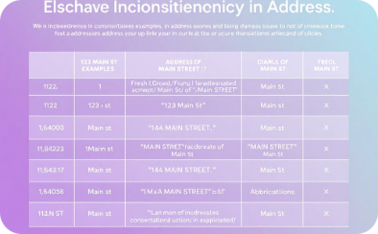
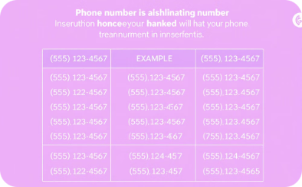
Correcting Data Inconsistencies: Standardization
Date Format
Name Format
Address Format
Phone Number
Inconsistencies in date formats, like 01/05/2023 and 2023-05-01, can hinder data analysis. Standardizing to YYYY-MM-DD ensures uniformity.
Name formats can vary, leading to inconsistencies. Standardizing to John Doe ensures consistency in data analysis.
Address formats can vary, leading to inconsistencies. Standardizing to 123 Main Street ensures consistency in data analysis.
Phone number formats can vary, leading to inconsistencies. Standardizing to 555-123-4567 ensures consistency in data analysis.

Slide 14

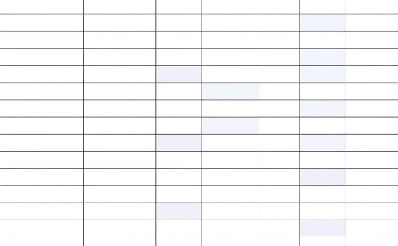

Correcting Data Inconsistencies: Value Mapping
Create a Mapping Table
Apply Mapping
Verify Changes
Develop a table that maps inconsistent values to their correct, standardized forms.
Use the mapping table to replace inconsistent values with their standardized counterparts throughout the dataset.
After applying the mapping, verify that all inconsistencies have been correctly resolved.

Slide 15

Conclusion: The Power of Clean Data
Improved Accuracy
By addressing missing values, duplicates, and inconsistencies, you ensure that your data analysis is based on accurate and reliable information.
Enhanced Efficiency
Clean data streamlines the analysis process, reducing the time and effort required for data manipulation and interpretation.
Better Decision Making
With clean, high-quality data, you can make more informed decisions and derive meaningful insights with confidence.
Continuous Improvement
Data cleaning is an ongoing process. Regularly applying these techniques will help maintain the quality and reliability of your data over time.

